Slide 1
Auto Exposure & Reinforcement Learning
DISP Group Meeting
R13942067 陳冠霖
2025/05/06

Slide 2
Outline
Camera Auto Exposure
Reinforcement Learning
Introduce Paper (Learning to Control Camera Exposure via Reinforcement Learning)
RL training framework
Training setting
Soft Actor-Critic (SAC)
Result
Reference

Slide 3
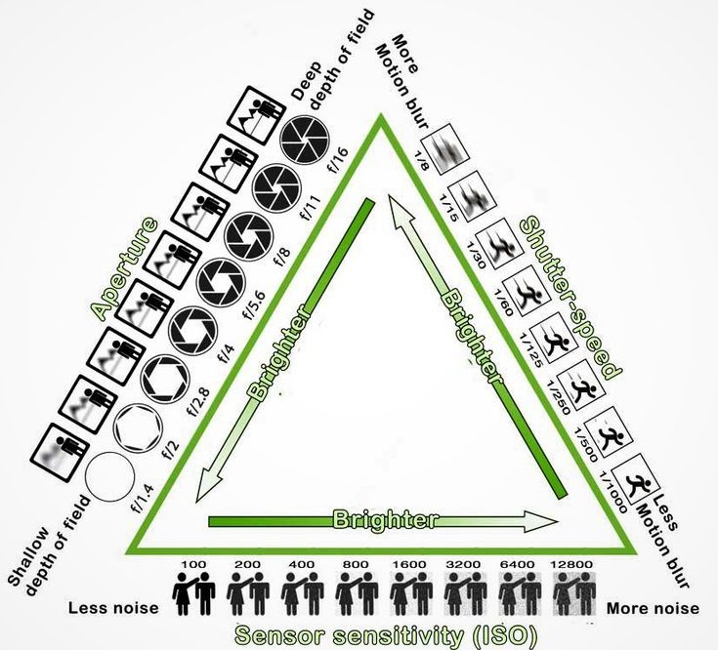
Camera Auto Exposure
Image Source

Slide 4
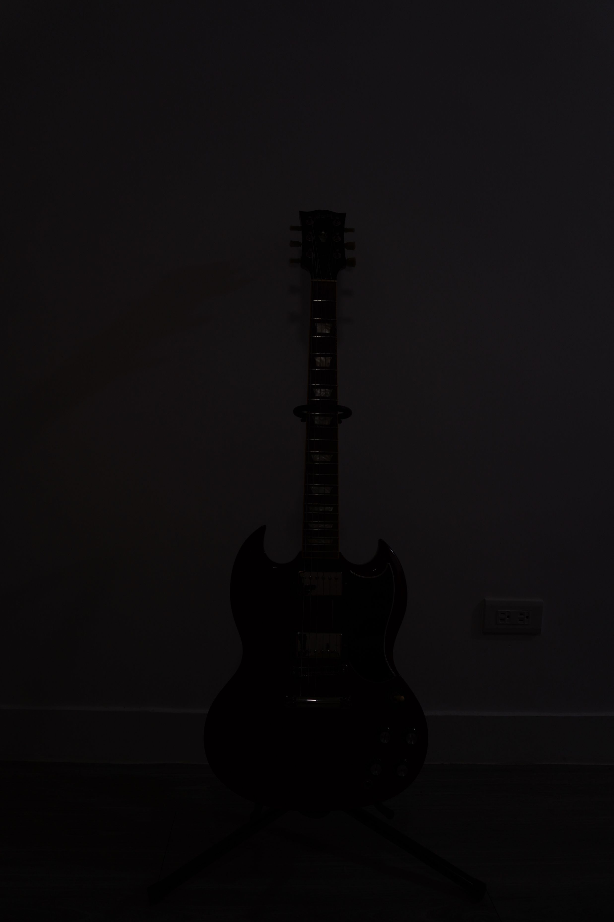
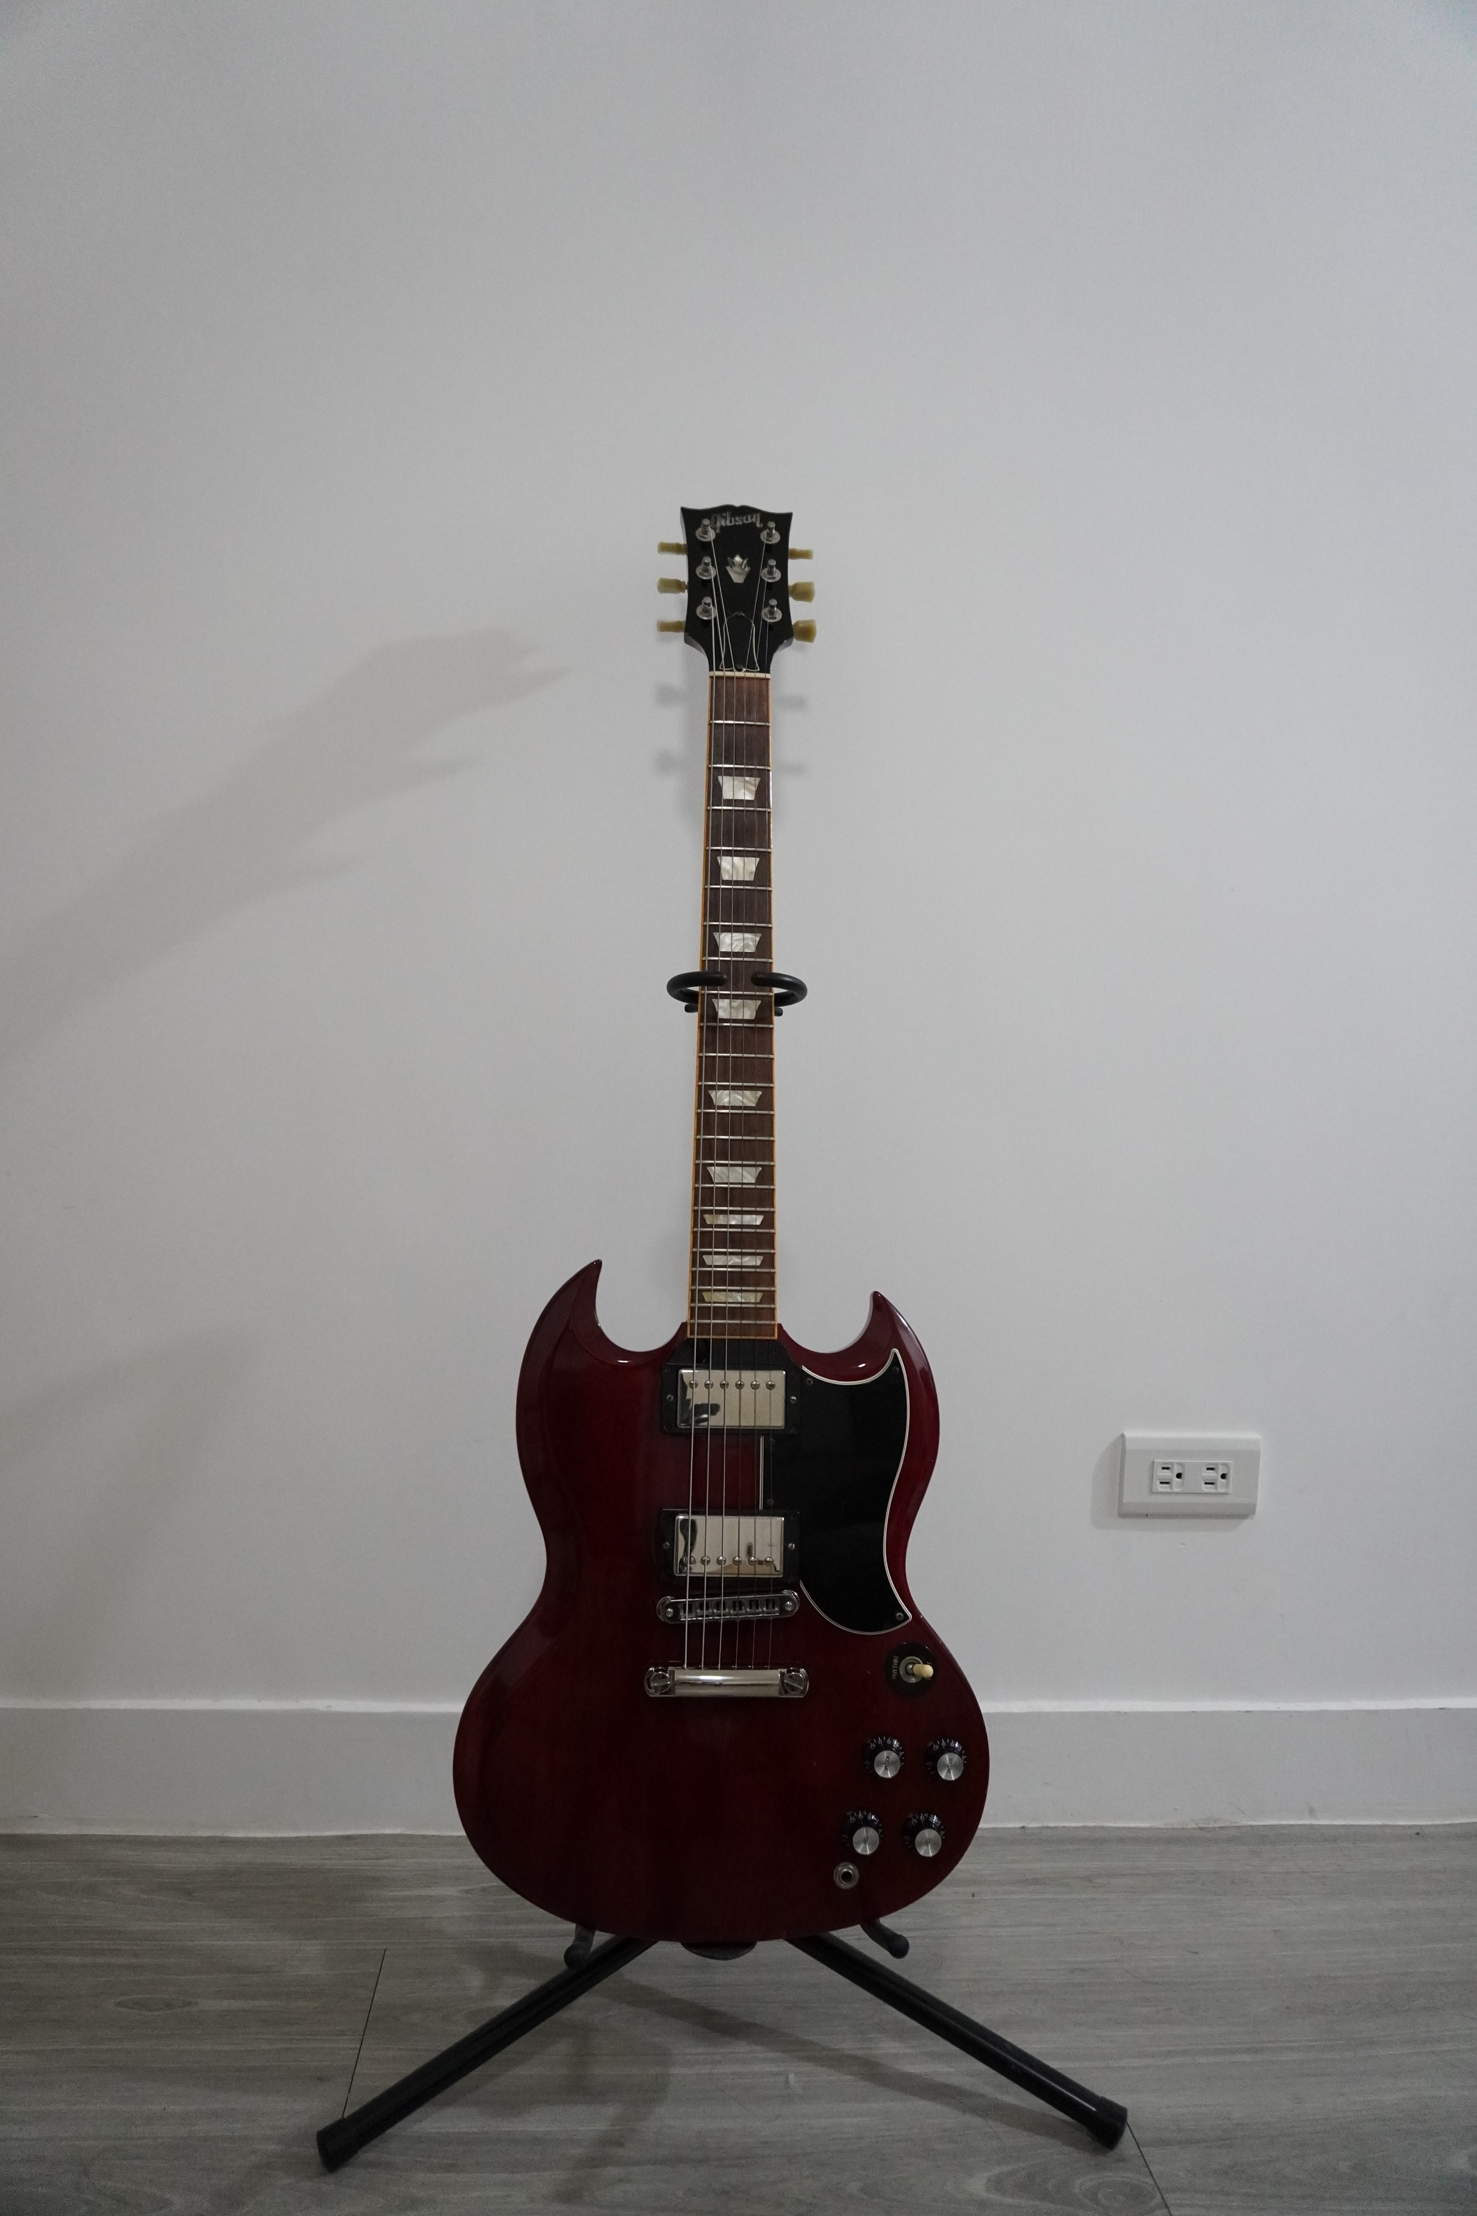
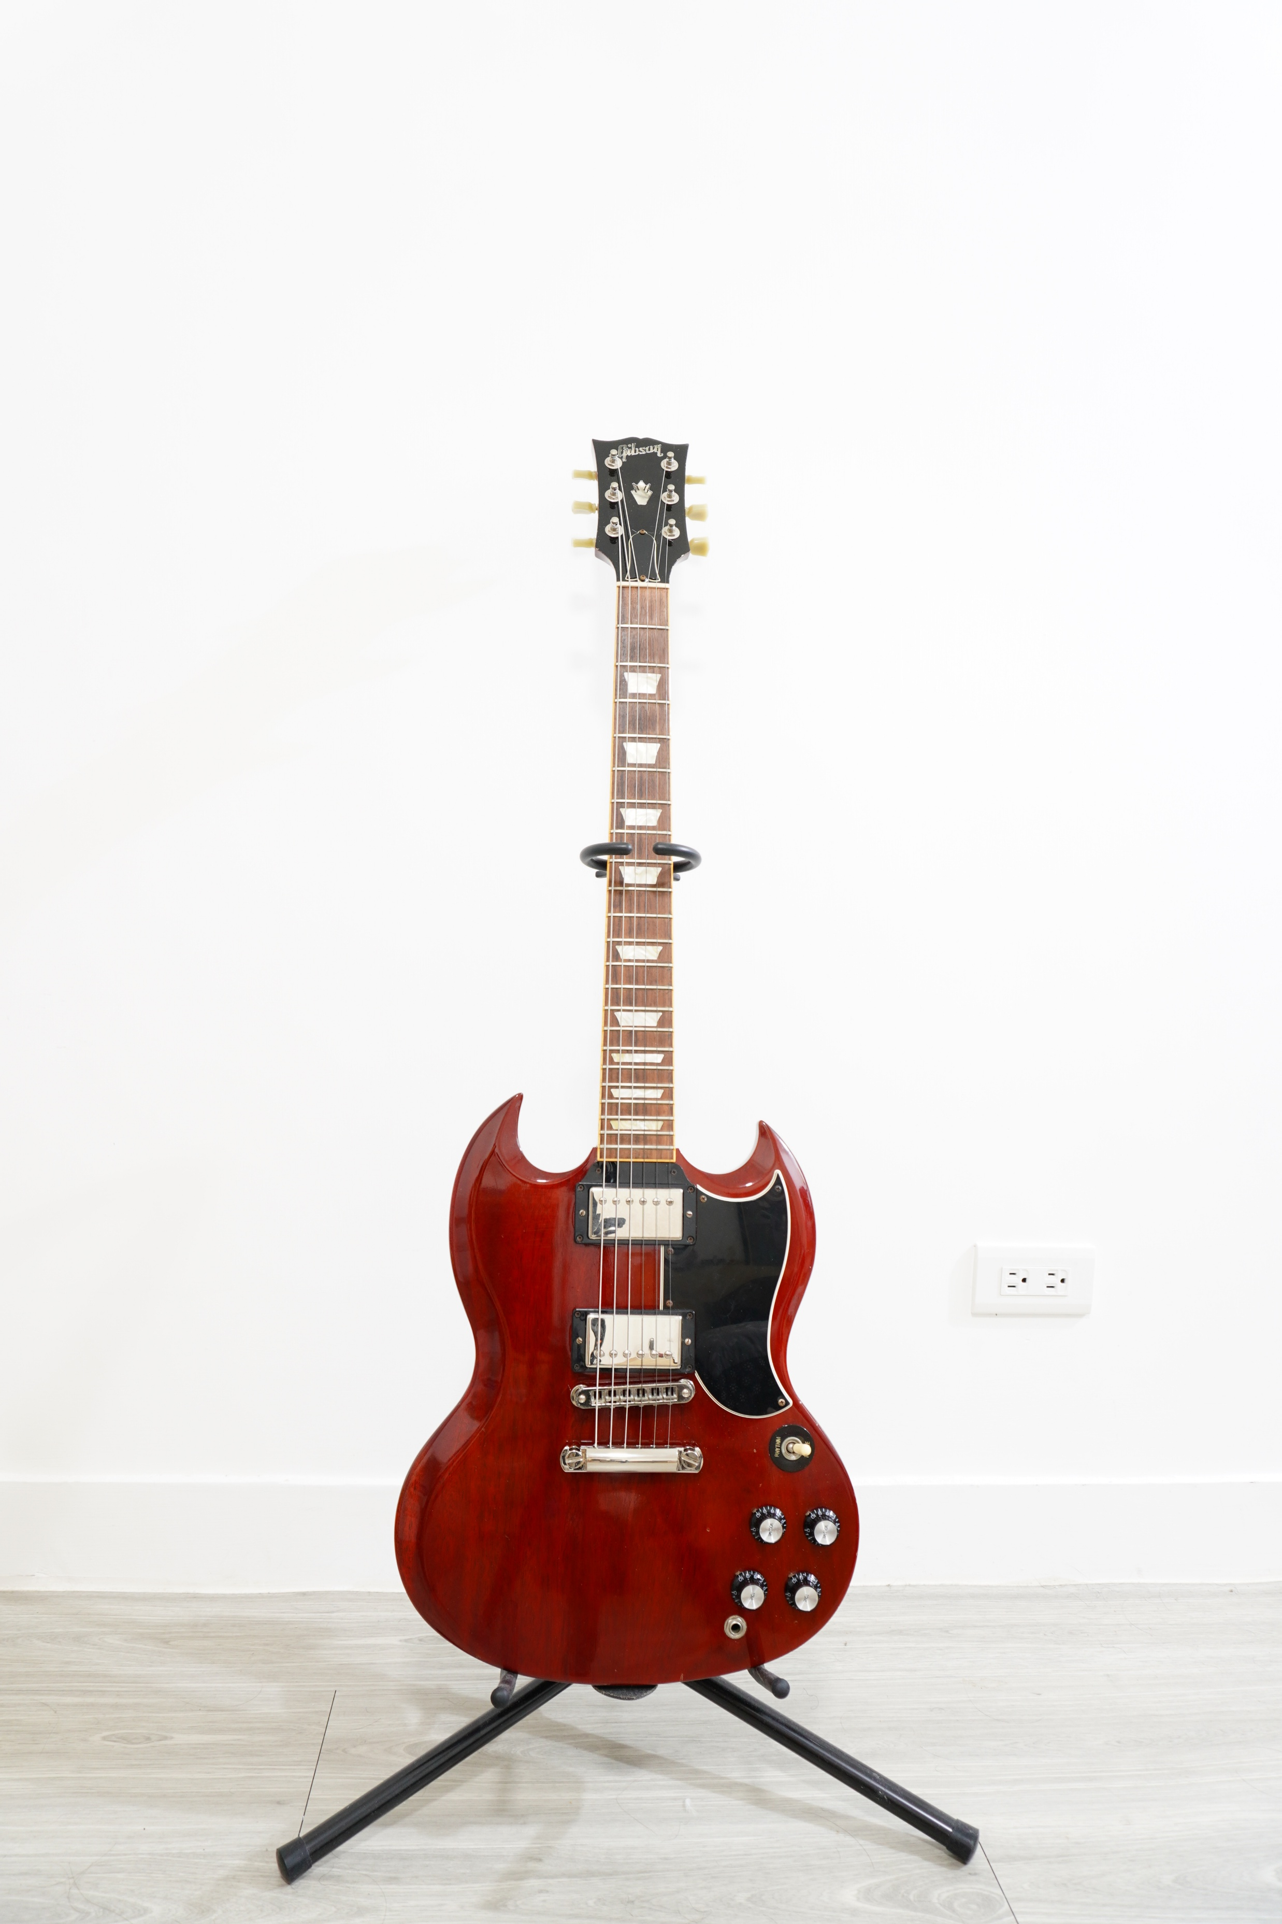
Camera Auto Exposure
Difference shutter speed & ISO setting (by Sony α-6400)
1/160s, ISO=100
1/160s, ISO=2500
Auto mode
1s, ISO=100

Slide 5
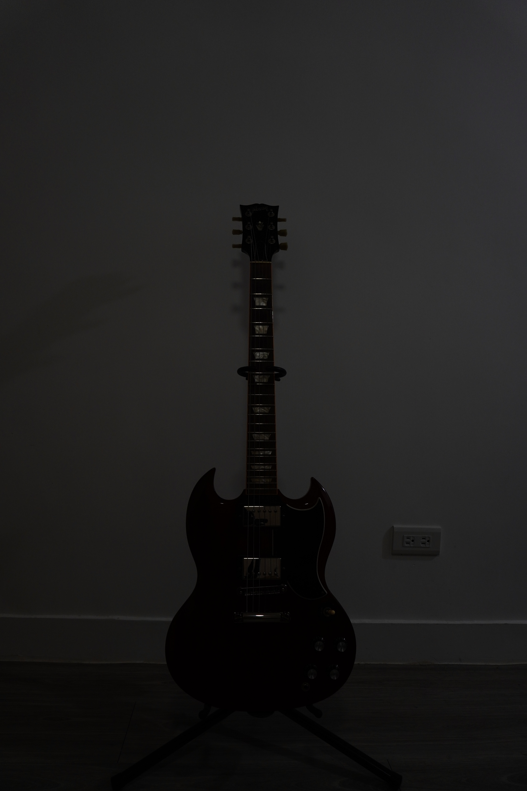
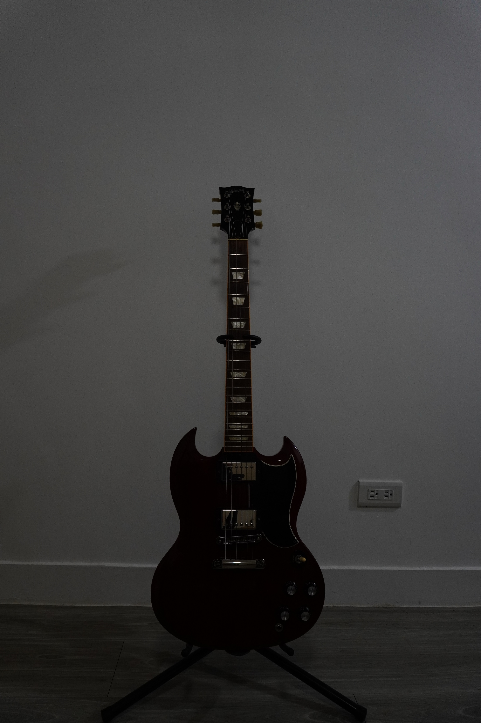
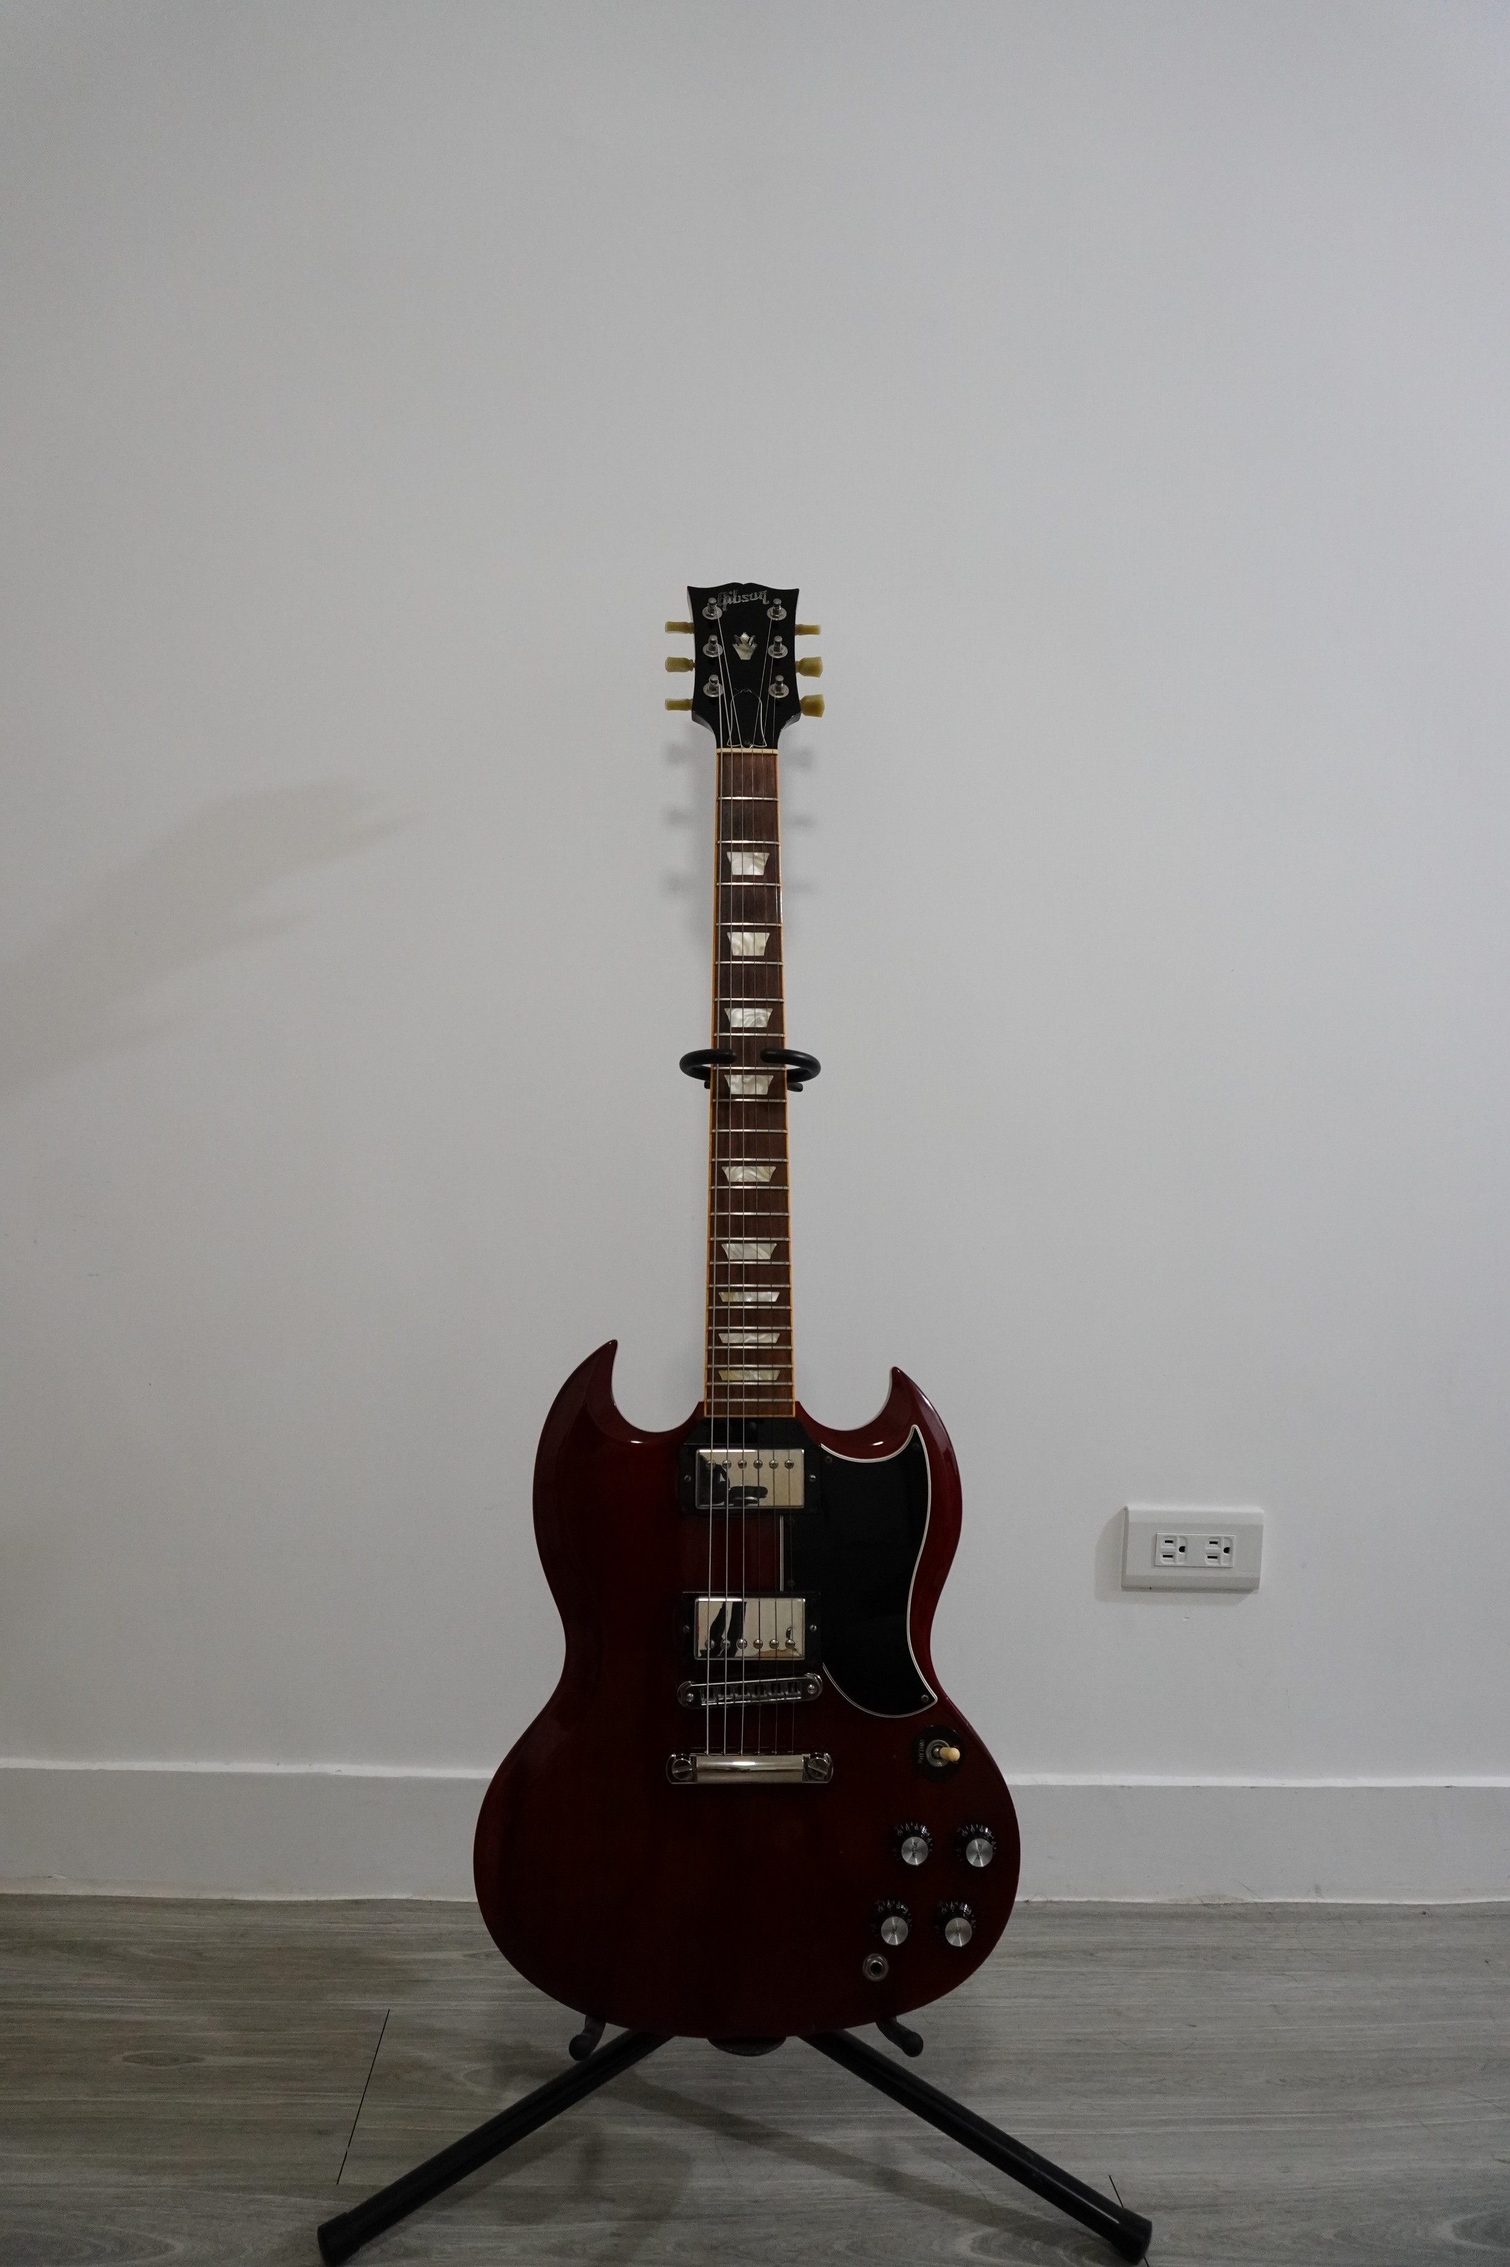
Camera Auto Exposure
Same shutter speed (1/50s) & difference ISO setting (by Sony α-6400)
ISO=320
ISO=640
ISO=2000

Slide 6
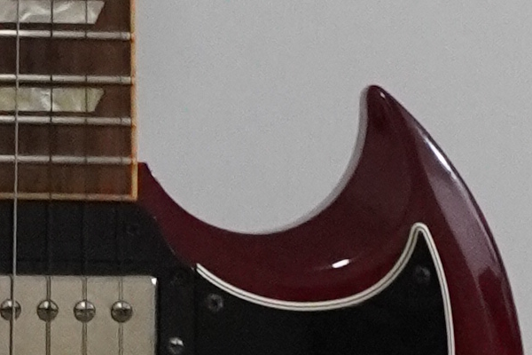
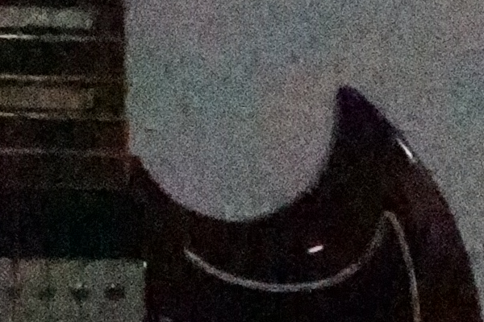
Camera Auto Exposure
High ISO setting will let image noisy (in JPEG file)
ISO=2500
ISO=65535

Slide 7
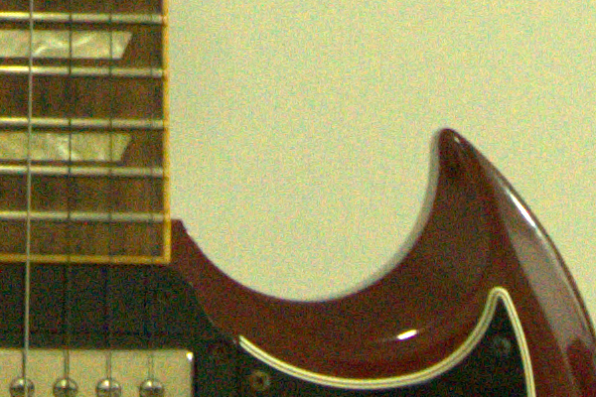
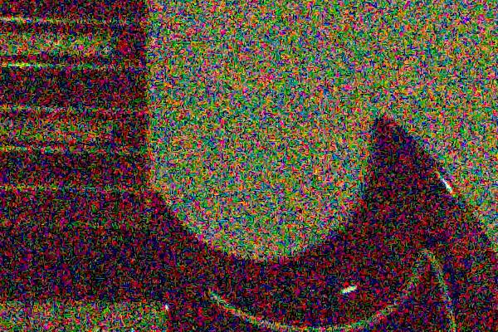
Camera Auto Exposure
High ISO setting will let image noisy (in RAW file)
ISO=2500
ISO=65535

Slide 8
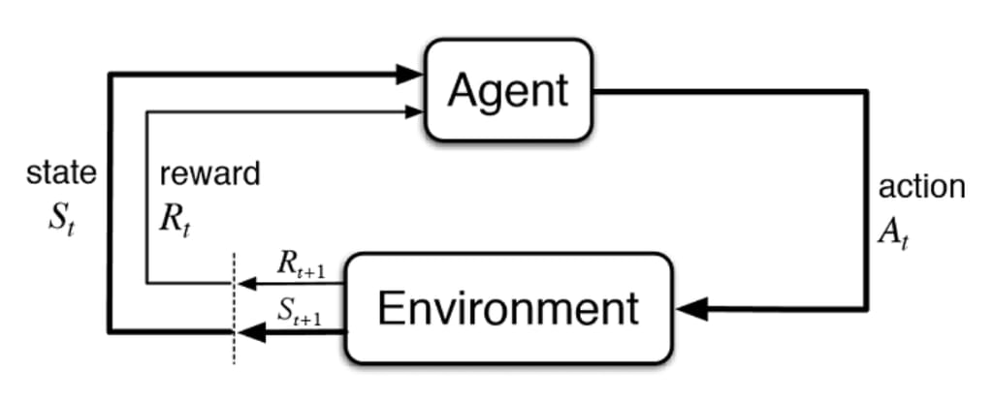
Reinforcement Learning
Image Source

Slide 9
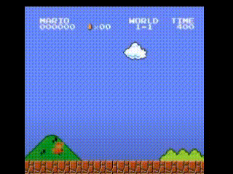
Reinforcement Learning
Image Source

Slide 10
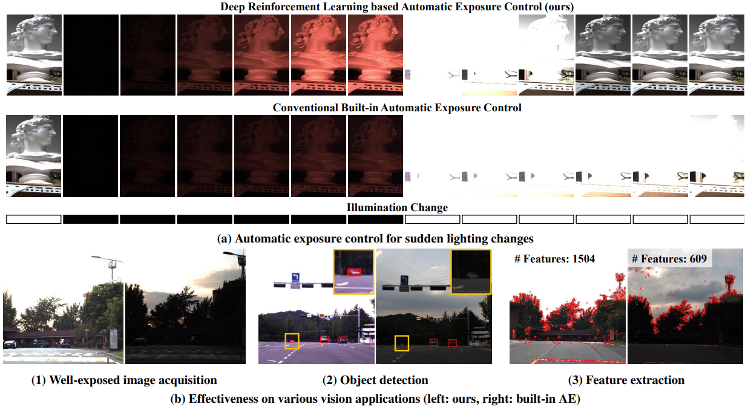
Introduce Paper
Paper title: Learning to Control Camera Exposure via Reinforcement Learning^{[1]}

Slide 11
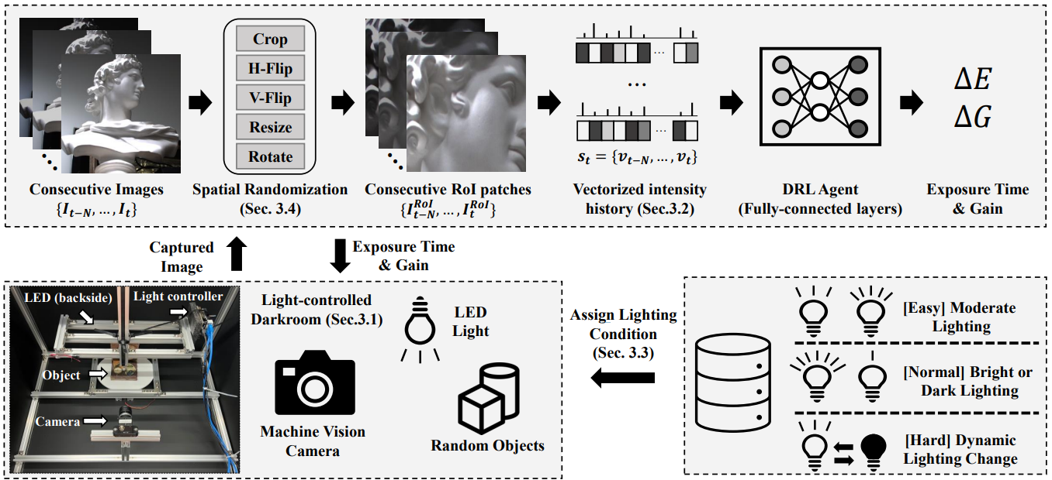
Introduce Paper
RL training framework

Slide 12
Introduce Paper
Training setting
Action: 曝光時間跟ISO值的調整量
State: 擷取灰階影像中ROI區域(128*128)的亮度值，沿 X 軸取平均，產生128維向量 𝑣𝑡。再堆疊當前以及前3個時間點的向量，組成狀態向量 𝑠𝑡。
Reward:
1.鼓勵畫面亮度趨近18度灰 ($ℛ_{mean}=\frac{1}{P}\sum_{xy}{{\left|I_{t}^{RoI}−0.5\right|}^{0.5}}$)
2.懲罰前後畫面變動太大的情況，抑制畫面變化閃爍 ($ℛ_{flk}=\frac{1}{P}\sum_{xy}{\left\|I_{t}^{RoI}−I_{t−1}^{RoI}\right\|}$)
3. Sobel強度高也代表noise過多，可以抑制希望不要使用到過高的ISO ($ℛ_{noise}=\frac{1}{P}\sum_{xy}{sobel(I_{t}^{ROI})}$)
$$ℛ_{total}=1.5ℛ_{mean}−ℛ_{flk}−0.1ℛ_{noise}$$
Algorithm: Soft Actor-Critic (SAC)^{[3]}
Policy network (agent): 兩層隱藏層的MLP，每層256 units，輸出為動作分布參數，agent會從這個分布中sample出action來和environment互動。

Slide 13
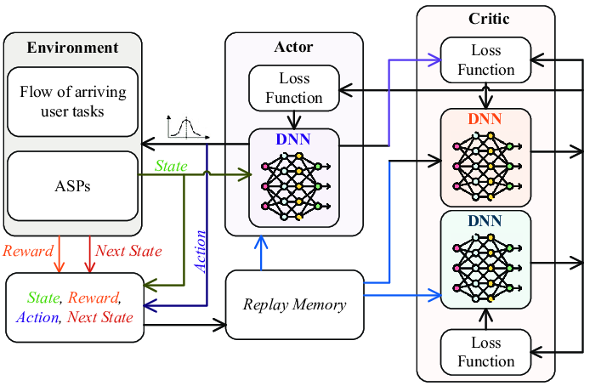
Introduce Paper
Soft Actor-Critic (SAC)
$$Q_{θ}$$
$$π_{φ}$$
$$J_{Q}\left(θ\right)=𝔼_{\left(s_{t},a_{t}\right)\sim D}\left[\frac{1}{2}{\left(Q_{θ}\left(s_{t},a_{t}\right)−\hat{Q}\left(s_{t},a_{t}\right)\right)}^{2}\right]$$
$$\hat{Q}\left(s_{t},a_{t}\right)=r\left(s_{t},a_{t}\right)+γ𝔼_{s_{t+1}\sim p}\left[V_{\overline{θ}}\left(s_{t+1}\right)\right]$$
$$J_{π}\left(φ\right)=𝔼_{s_{t}\sim D}[𝔼_{a_{t}\sim π_{θ}}[α\log\left(π_{φ}\left(a_{t} | s_{t}\right)\right)$$
$−Q_{θ}(s_{t},a_{t})]]$
$$r\left(s_{t},a_{t}\right)$$
$$D$$
Image Source

Slide 14
Introduce Paper
Soft Actor-Critic (SAC)
Advantages
穩定學習
探索能力強
訓練樣本使用效率高
Limitations
演算法比較複雜
需要大量互動資料
對reward設計敏感
Image Source

Slide 15
Introduce Paper
Training tricks
Curriculum Learning
分成三個難度等級，訓練時依據難度循序漸進。
Easy: 固定光照、亮度適中
Normal: 固定光照，但偏暗或偏亮
Hard: 動態光照變化(突然開關燈等光照劇烈變動的情況)
Spatial Domain Randomization
訓練時對每張影像隨機做cropping, flipping, rotation, resize等會影響空間結構，但不改變亮度的操作，藉此加強模型對環境的泛化能力。

Slide 16
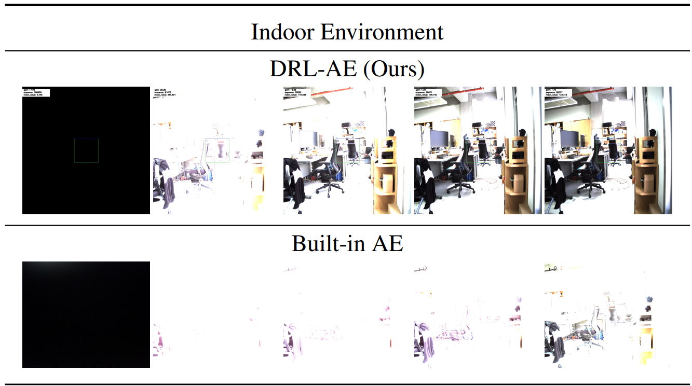
Introduce Paper
Result

Slide 17
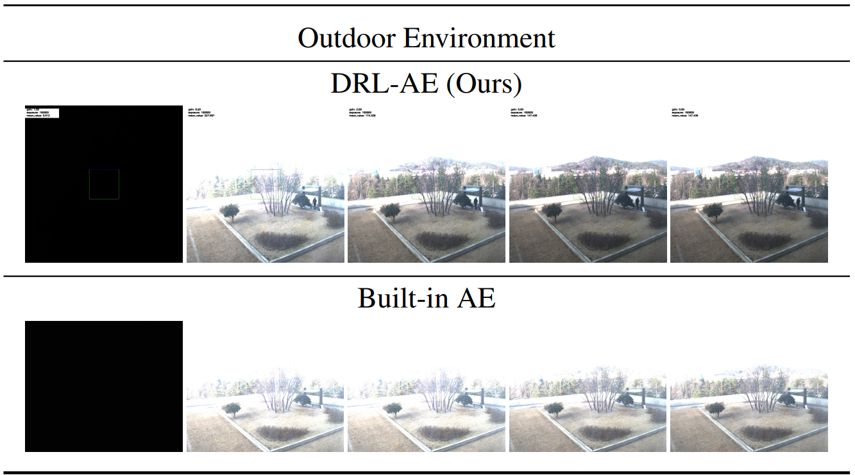
Introduce Paper
Result

Slide 18
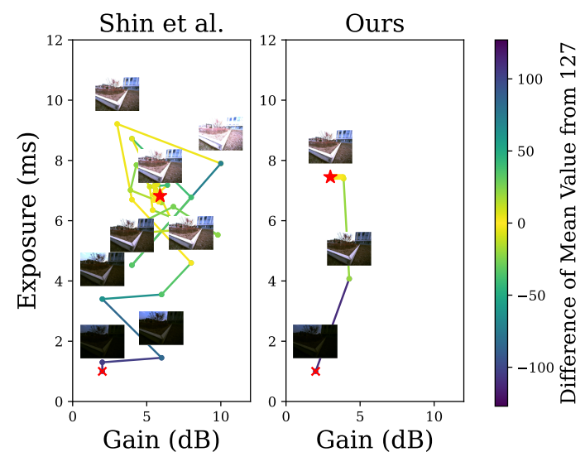
Introduce Paper
Result

Slide 19
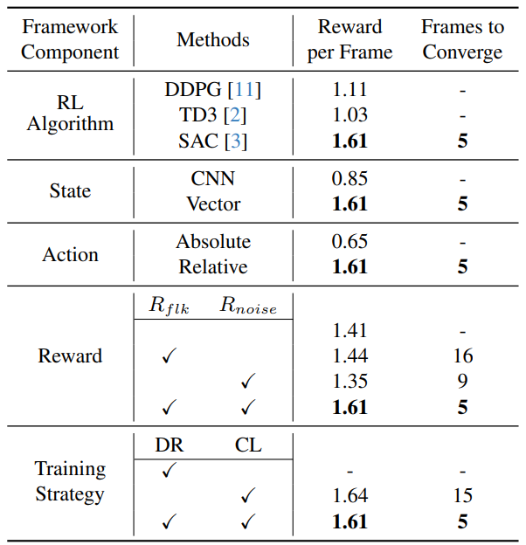
Introduce Paper
Result

Slide 20
Reference
[1] U.Shin, J.Park, G.Shim, F.Rameau, andI. S.Kweon, “Camera Exposure Control for Robust Robot Vision with Noise-Aware Image Quality Assessment,” Jul.2019, [Online]. Available: http://arxiv.org/abs/1907.12646
[2] K.Lee, U.Shin, andB.-U.Lee, “Learning to Control Camera Exposure via Reinforcement Learning,” Apr.2024, [Online]. Available: http://arxiv.org/abs/2404.01636
[3] T.Haarnoja, A.Zhou, P.Abbeel, andS.Levine, “Soft Actor-Critic: Off-Policy Maximum Entropy Deep Reinforcement Learning with a Stochastic Actor,” Jan.2018, [Online]. Available: http://arxiv.org/abs/1801.01290

Slide 21
Appendix

Slide 22
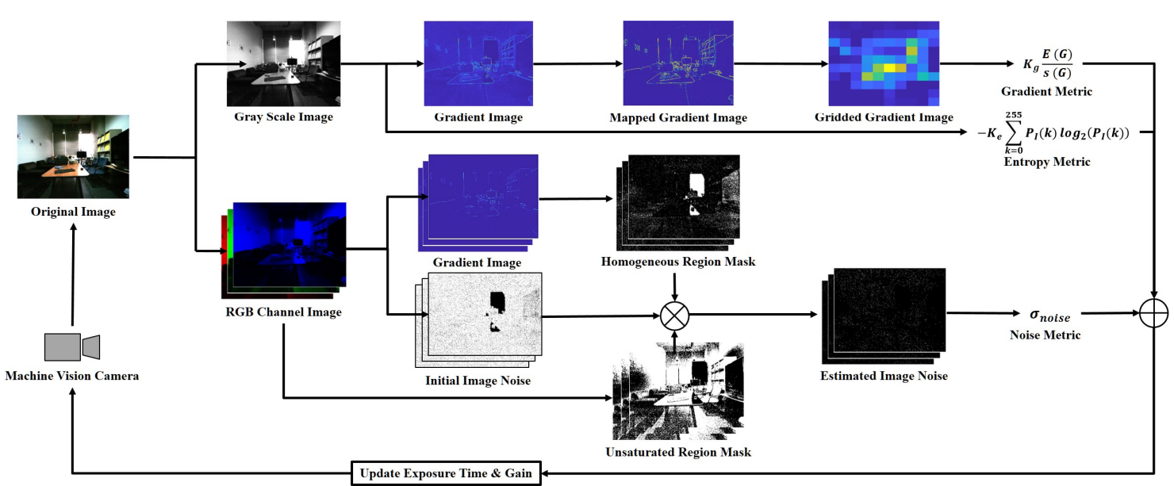
Appendix
Image Source

